Slide 1
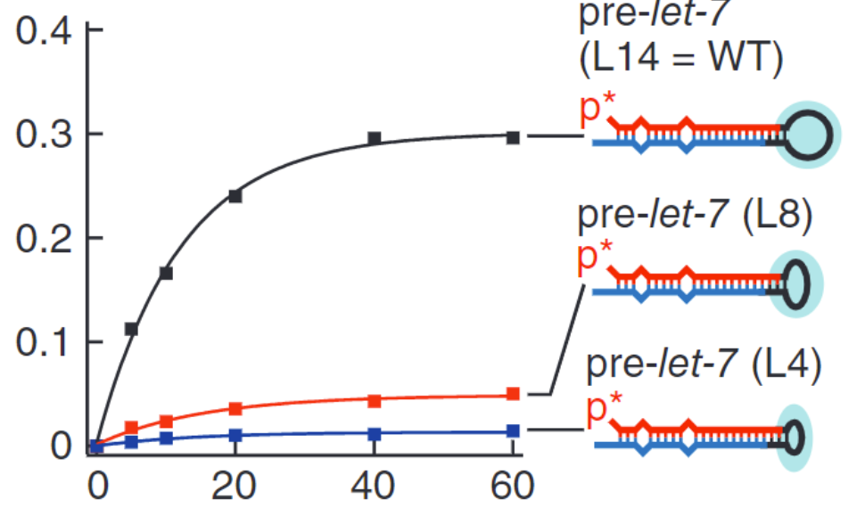
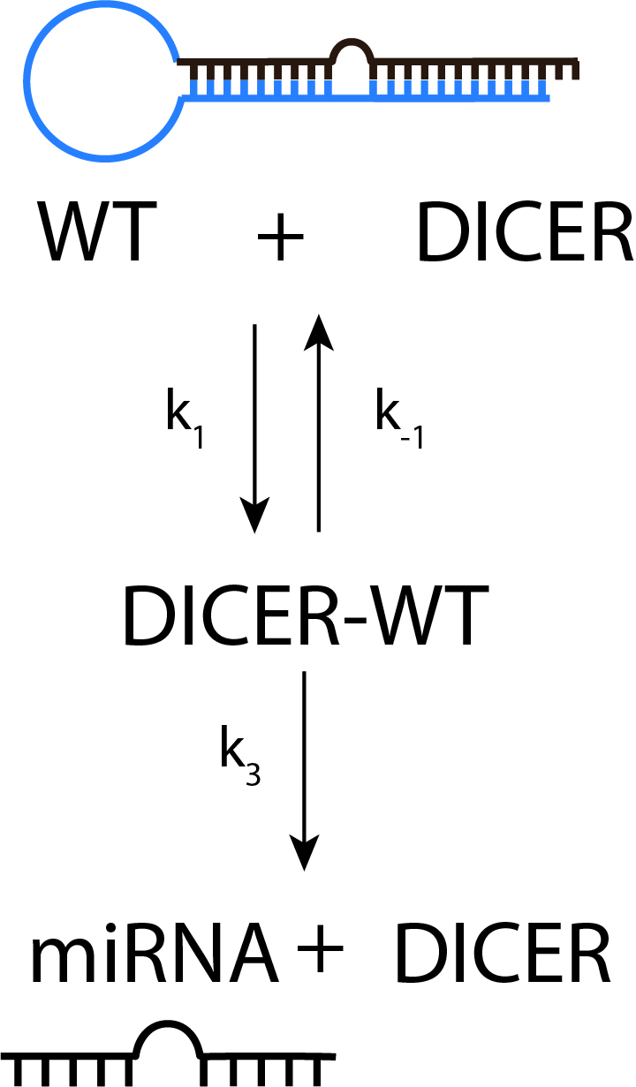
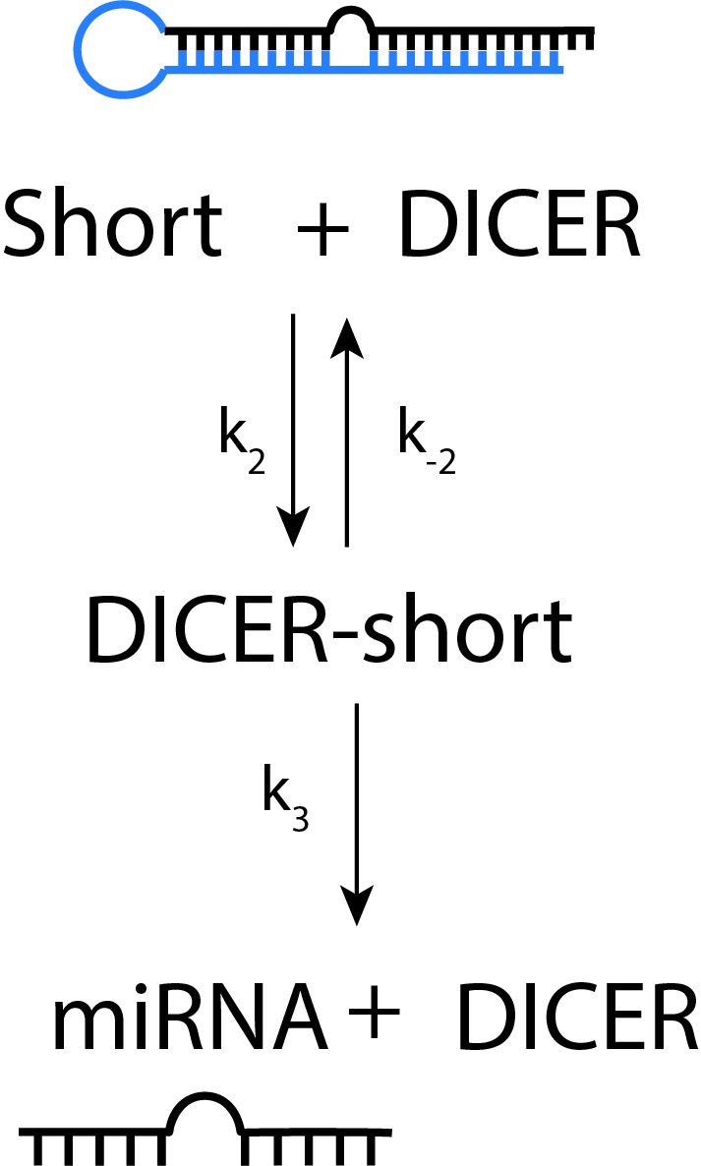
Model background

Slide 2
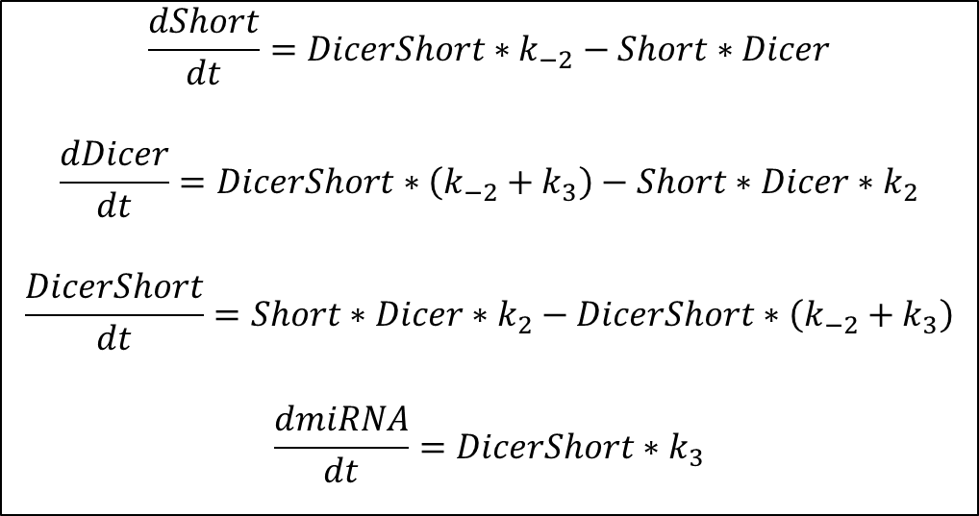
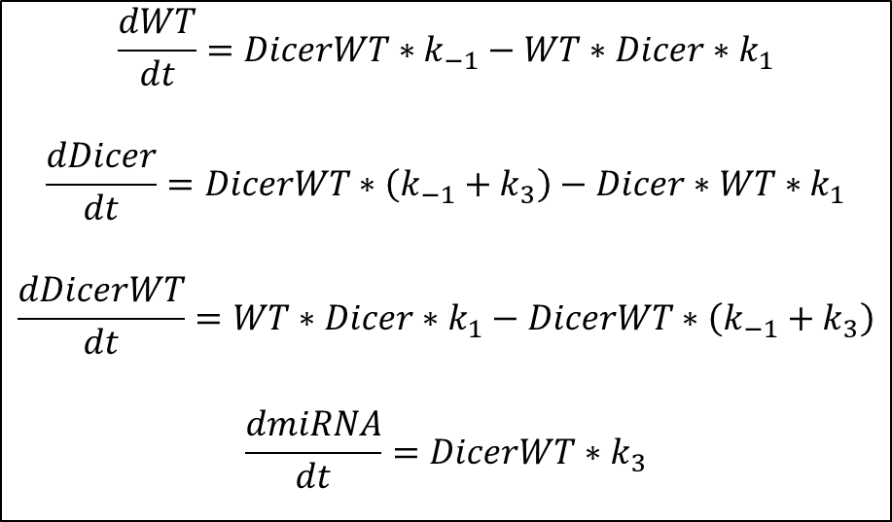
Model(s)
$$\frac{dWT}{dt}=DicerWT∗k_{−1}−WT∗Dicer∗k_{1}$$
$$\frac{dDicer}{dt}=DicerWT∗\left(k_{−1}+k_{3}\right)−Dicer∗WT∗k_{1}$$
$$\frac{dDicerWT}{dt}=WT∗Dicer∗k_{1}−DicerWT∗\left(k_{−1}+k_{3}\right)$$
$$\frac{dmiRNA}{dt}=DicerWT∗k_{3}$$
$$\frac{dShort}{dt}=DicerShort∗k_{−2}−Short∗Dicer$$
$$\frac{dDicer}{dt}=DicerShort∗\left(k_{−2}+k_{3}\right)−Short∗Dicer∗k_{2}$$
$$\frac{DicerShort}{dt}=Short∗Dicer∗k_{2}−DicerShort∗\left(k_{−2}+k_{3}\right)$$
$$\frac{dmiRNA}{dt}=DicerShort∗k_{3}$$

